Slide 1
Flutter Session it-Sharks
Welcome Again !

Slide 2

Agenda
Async / Await
Future Object
Databases
Sqflite package

Slide 3
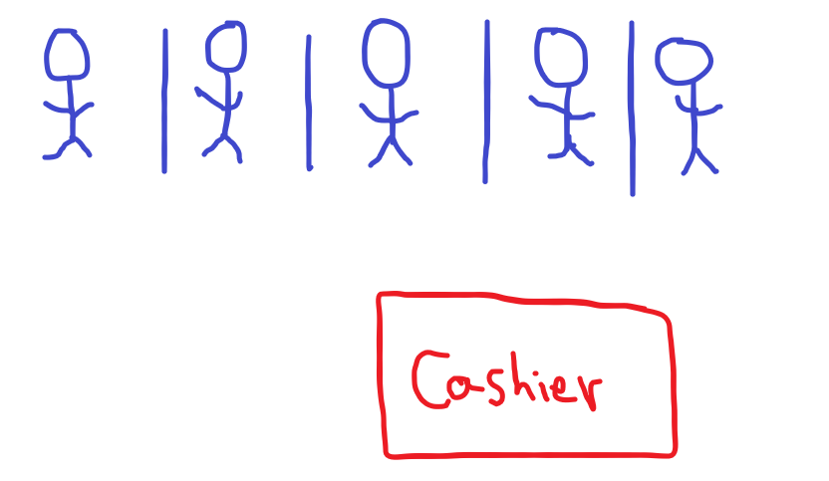
Async / Await
Let’s assume we are in a supermarket and have a lot of customers want to checkout , and we only have one cashier in the supermarket , so how the checkout process is done?

Slide 4
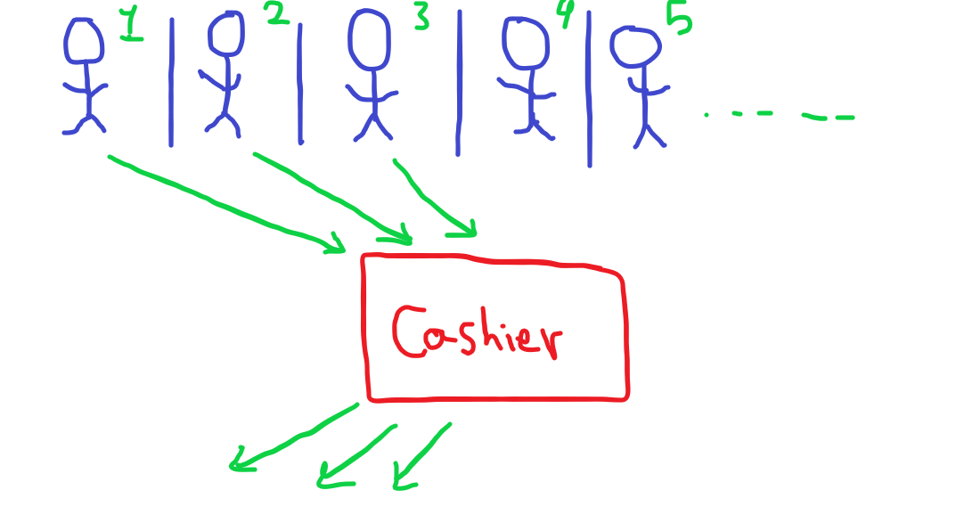
Async / Await
Each customer will go to checkout , for that if each customer take at least 2 seconds we will take a 10 seconds until the last customer checkout and leave the supermarket

Slide 5
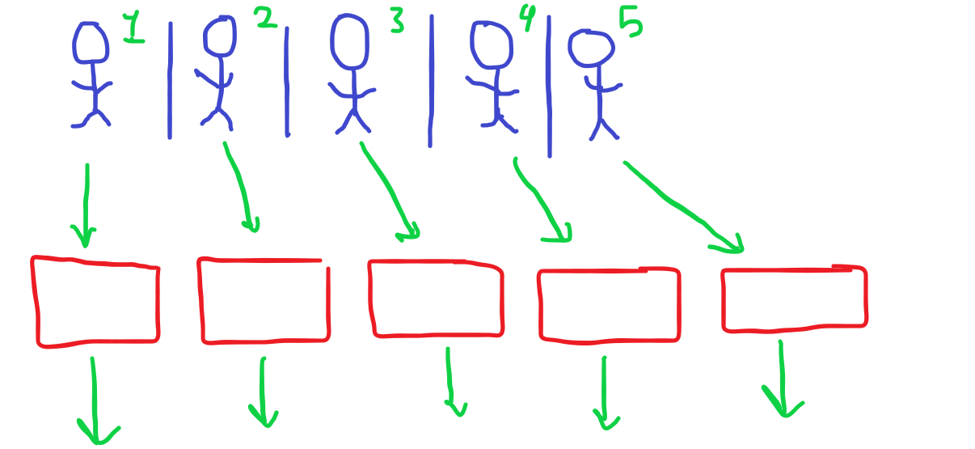
Async / Await
Now assume if we have number of cashiers equivalent to number of customers, it will make it easy that the total time we will take is 2 seconds (if all customers take 2 seconds to checkout)

Slide 6
Async / Await
From the previous example we can deduce the following
Clients represent the operations that occur in the application, such as pressing a button, displaying data, interacting with the user interface, or getting data from database
The cashier represents the processor(Thread) responsible for carrying out these operations, whether they take a long time or a short time

Slide 7
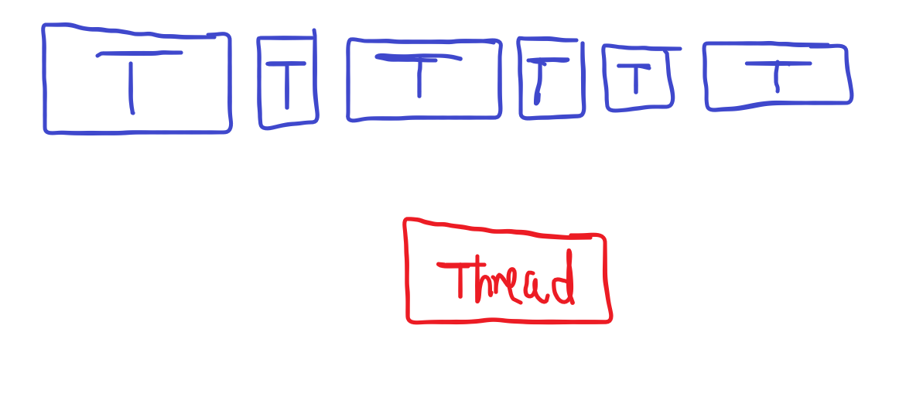
ASYNC / AWAIT
Now , what is the problem if we have only one thread to run the operations on it ?
Correct , it will cause crashing or if we have one operation take a lot of time we must wait for it until it finish

Slide 8
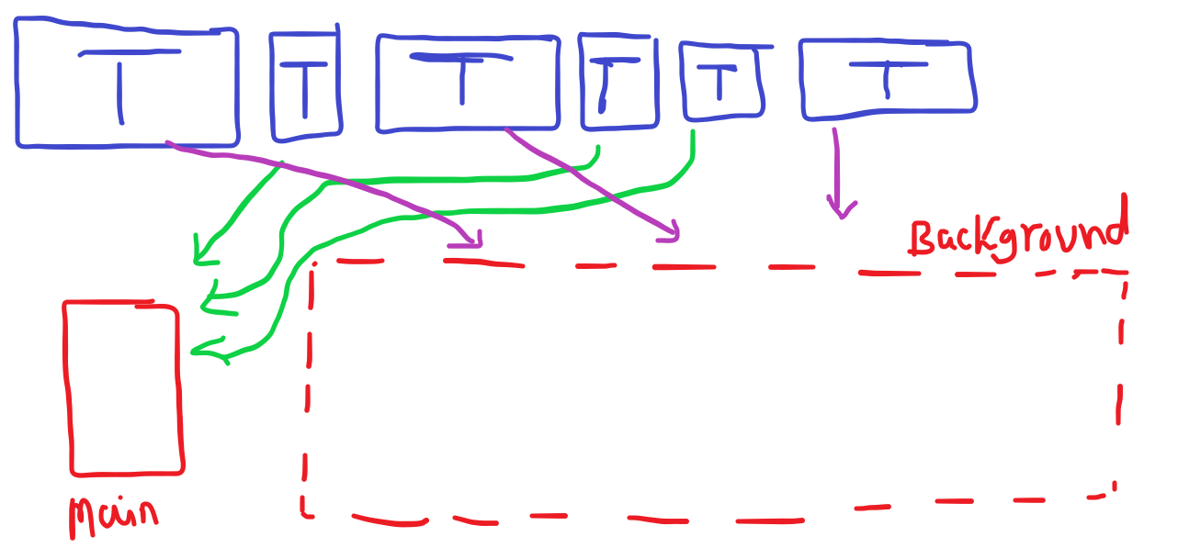
Async / Await
An activity that is well-known to be slow is started up as normal.
The moment it begins waiting for something — disk, HTTP request, whatever — it is moved away from the CPU.
A listener of sorts is created. It monitors the activity and raises an alert when it is finished waiting.
The reference to that listener is returned to the main thread. This reference object is known as a Future.
The main thread continues chugging along its merry way.
When the waiting activity is finally resolved, the event loop sees it and runs an associated method on the main thread to handle finishing up the slow event.

Slide 9
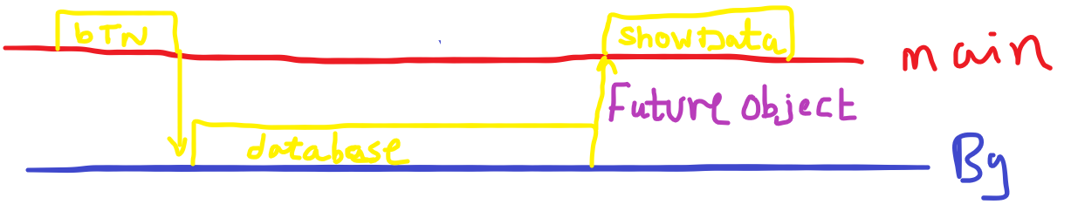
ASYNC / AWAIT

Slide 10
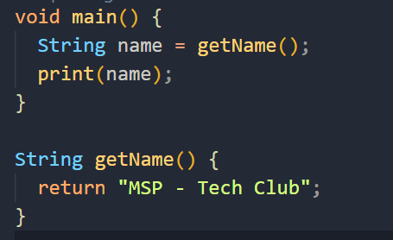
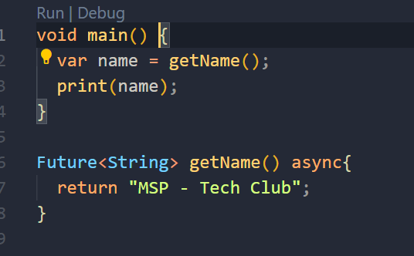
Future Object
Output : MSP – Tech Club
Output : Instance of ‘Future<String>’

Slide 11
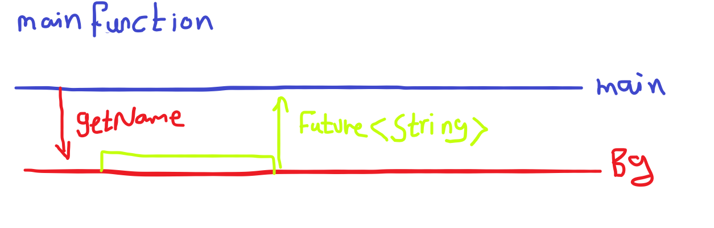
FUTURE OBJECT

Slide 12
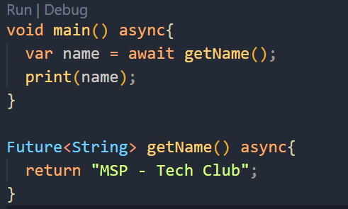
Future Object
Wait until the function return the string
Use Await Keyword

Slide 13

Databases
Hierarchical databases.
Network databases.
Relational databases.
Object-oriented databases.

Slide 14
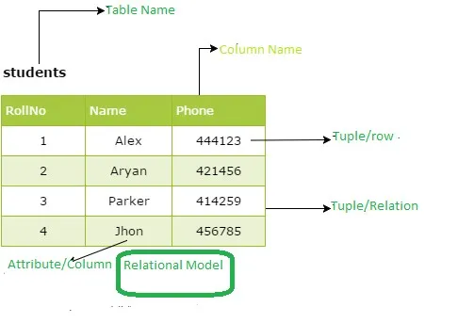
Rational Databases
In the relational model, three key terms are heavily used such as relations, attributes, and domains. A relation nothing but is a table with rows and columns. The named columns of the relation are called attributes, and finally, the domain is nothing but the set of values the attributes can take. The following figure gives us an overview of a rational database model.

Slide 15
Rational Databases
Tuple: Each row in a table is known as a tuple.
The cardinality of a relation: The number of tuples in a relation determines its cardinality. In this case, the relation has a cardinality of 4.
Degree of a relation: Each column in the tuple is called an attribute.
The number of attributes in a relation determines its degree. The relation in the figure has a degree of 3.

Slide 16
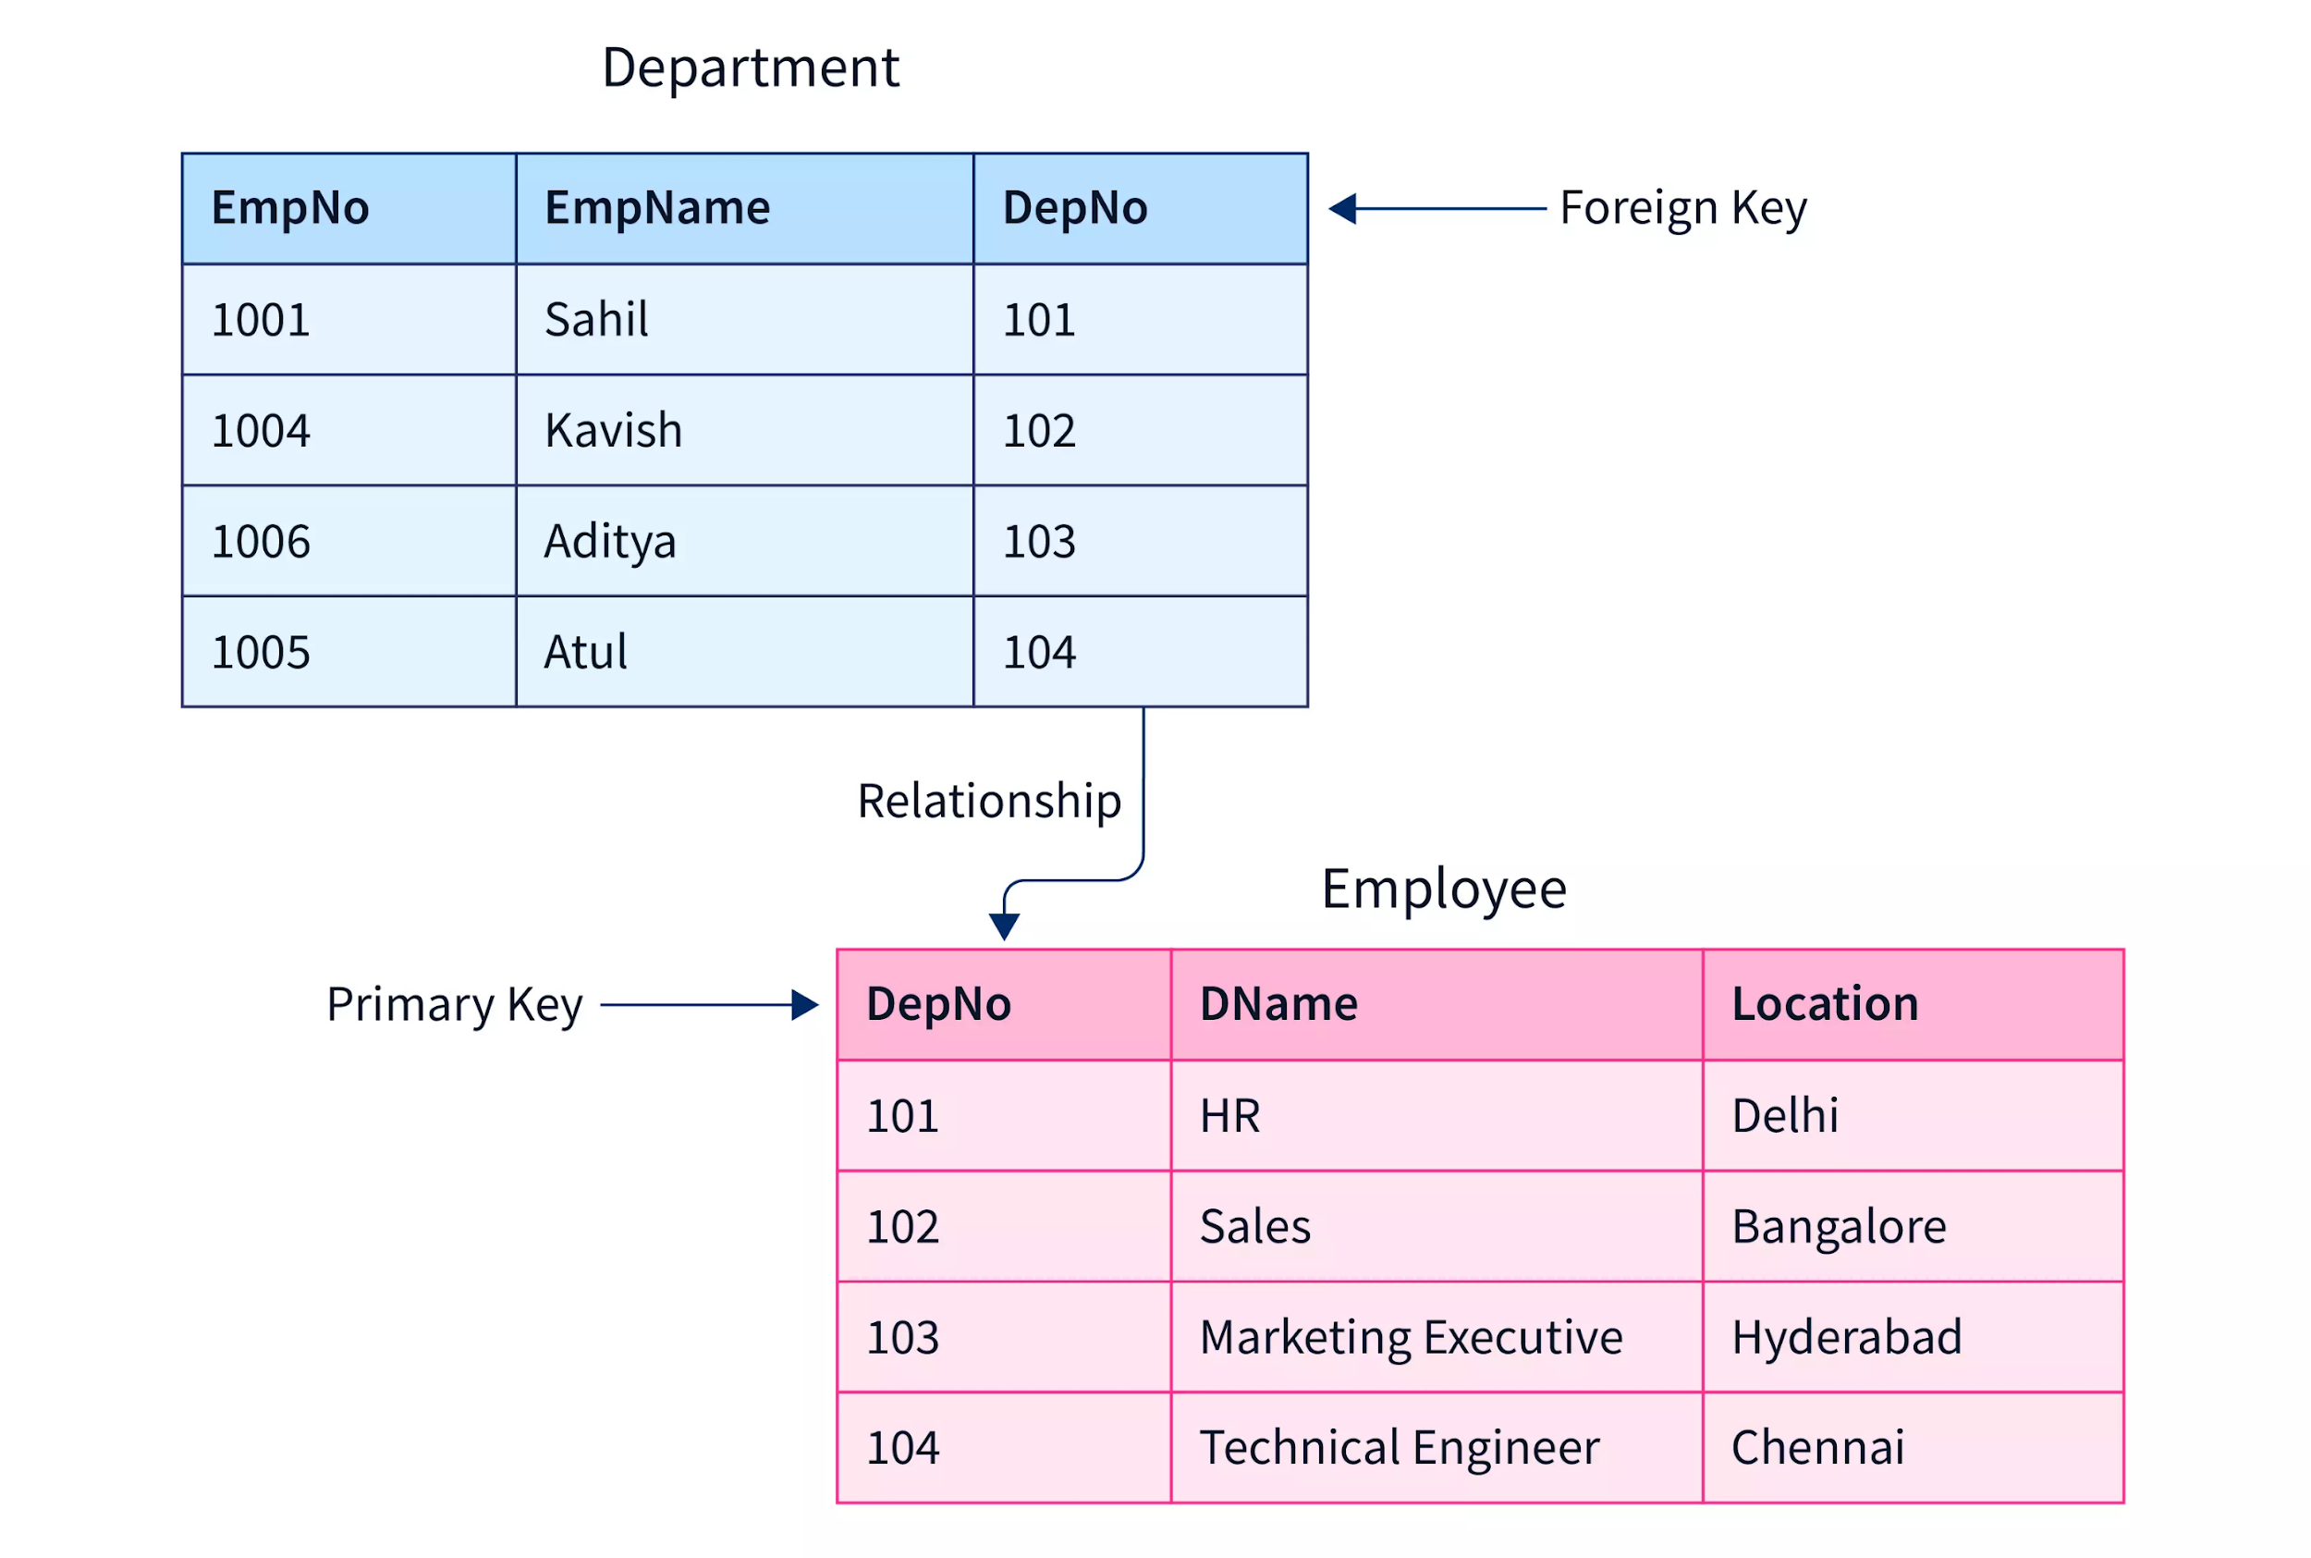
Rational Databases
Keys of a relation
Primary key- it is the key that uniquely identifies a table. It doesn’t have null values.
Foreign key- it refers to the primary key of some other table.it permits only those values which appear in the primary key of the table to which it refers

Slide 17
Rational Databases
Types
SQL Databases
Oracle
Microsoft SQL Server
PostgreSQL

Slide 18
BREAK

Slide 19
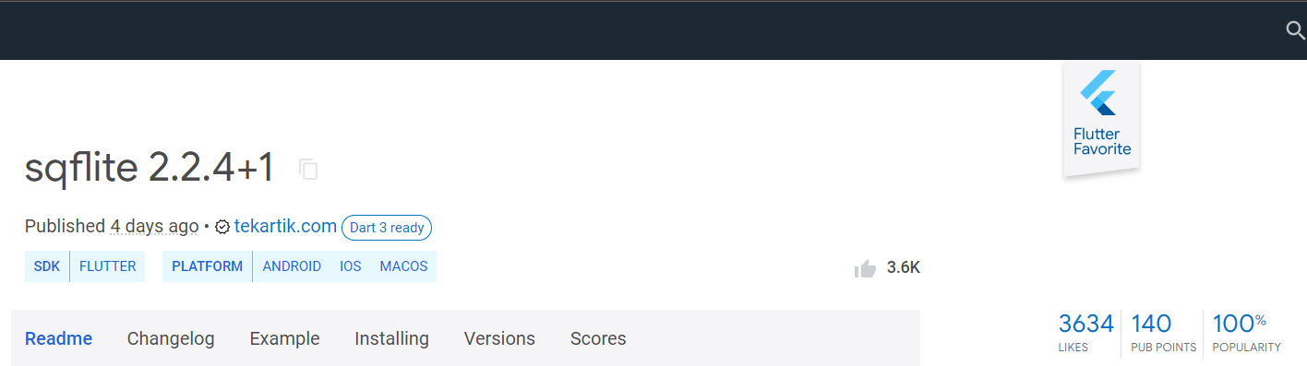
Why SQFLite?
SQLite is one of the most popular ways to store data locally.
Sqflite is one of the most used and up to date packages for connecting to SQLite databases in Flutter

Slide 20

SQFLite
SQLite plugin for Flutter. Supports iOS, Android and MacOS.
Support transactions and batches
Automatic version management during open
Helpers for insert/query/update/delete queries
DB operation executed in a background thread on iOS and Android

Slide 21
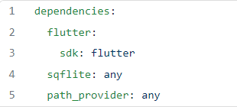
Add dependencies to your project
In your project go to pubspec.yaml and look for dependencies. Under dependencies, add the latest version of sqflite and path_provider (use the right numbers from Pub)

Slide 22
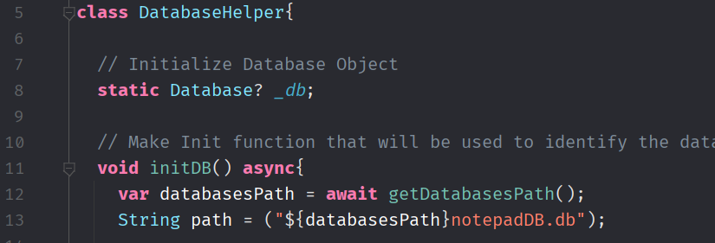
Create Database Helper Class
Now , let’s code the Database Helper class ☺
In our hands on we will make a database for notepad application ☺
It takes a note with the date when we create it ☺

Slide 23
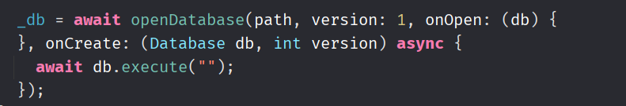
Create Database Helper Class
Opendatabase require the path that we get previous for database
Named parameters such as
Version : we can give it any number
onOpen: take a method will be performed when the database is opened
onCreate : take a method that will be performed when we create the database (once)
Can you guess the SQL Statement that will we use to create the table ?
CREATE TABLE notes (id INTEGER PRIMARY KEY, note TEXT, date TEXT)

Slide 24
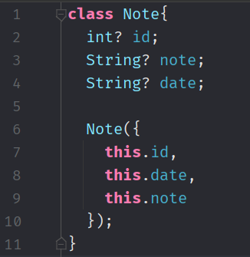
Create Model Class
So now we need to make a class that we will use to make operations on database such as insert , retrieve , update , and delete
In our example we make a notepad app which it’s model consist of :
Id (primary Key)
Note (String)
Date (String)

Slide 25
CRUD Operations
Create (Insert Query / Queries)
Read (Get Query/Queries)
Update (Hands on)
Delete (Hands on)

Slide 26
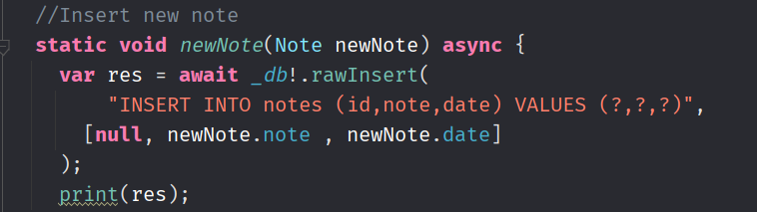
Create new Note function
To insert new note we need to add note and a date

Slide 27
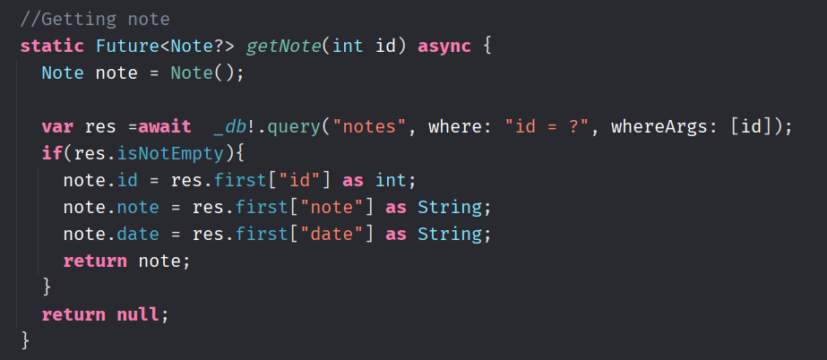
Retrieve note from database

Slide 28
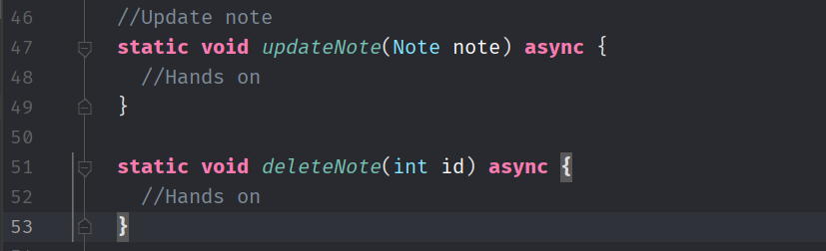
UPDATE , DELETE
Now it’s your turn to impelement those functions ☺
Helper Methods
update (
table name ,
map(from the object you want to update) ,
where : where condition e.g.(id = ?) ,
whereArgs = [arguments that will be replaced instead of ?])
delete (
table name ,
where : where condition e.g.(id = ?) ,
whereArgs = [arguments that will be replaced instead of ?])

Slide 29
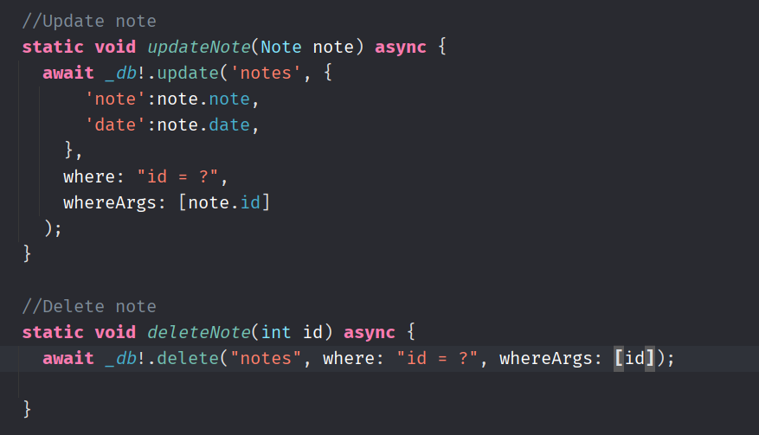
HANDS ON ANSWER

Slide 30

Resources
https://pub.dev/packages/sqflite
https://medium.com/flutter-community/using-sqlite-in-flutter-187c1a82e8b
https://medium.com/@muddaprince456/types-of-databases-bfdab96cfe3
https://medium.com/flutter-community/futures-async-await-threading-in-flutter-baeeab1c1fe3
https://dart.dev/codelabs/async-await

Slide 31

THANK YOU

